Slide 1

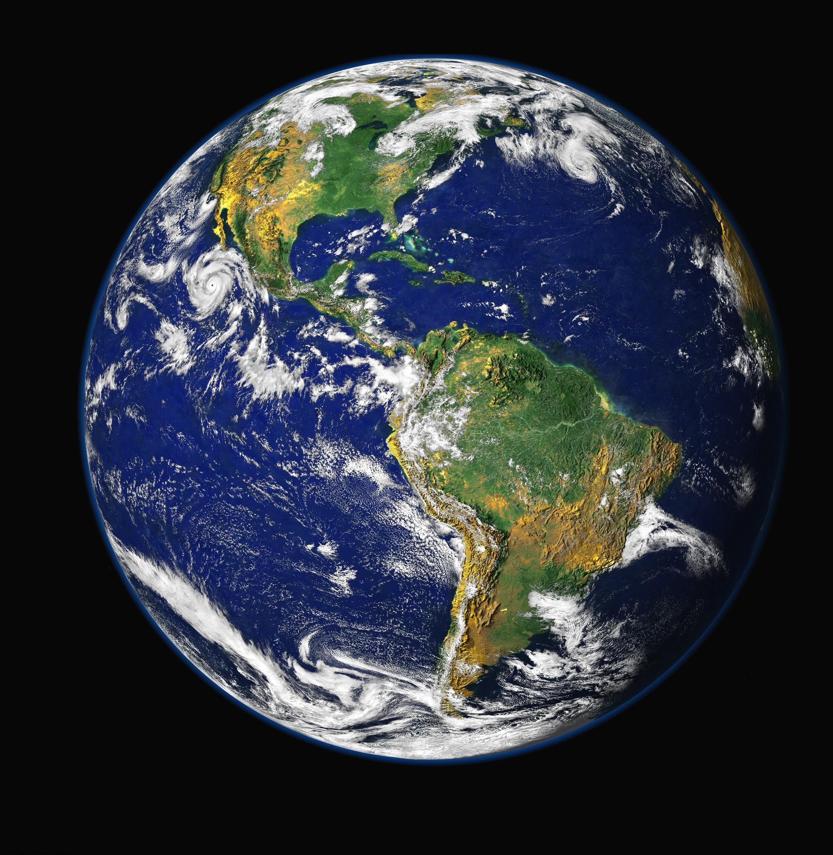
We Should Know What Orbits our Planet
The Need for a Space Debris Analytics Program

Slide 2


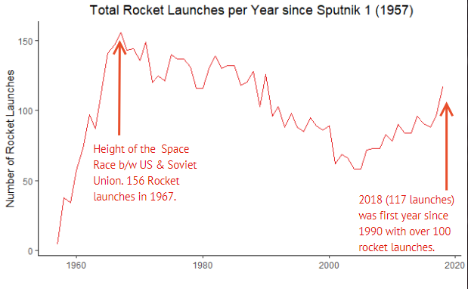
We Are in a NEW SPACE AGE
Space Economy is in another renaissance, 62 years since Sputnik 1 and 50 since the end of Space Race
Things we rely on satellites for today:
Location bases applications (Uber, Lyft, YELP, social media, dating apps, etc.)
Banking
Agriculture
Climate forecasting
New Players in space
Government:
China|India|Europe (ESA)|Japan
Commercial:
SpaceX| BlueOrigin| Rocket Lab| Space Angels

Slide 3
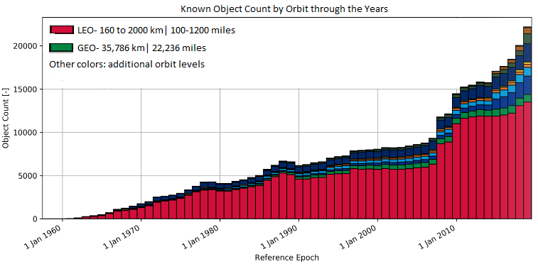
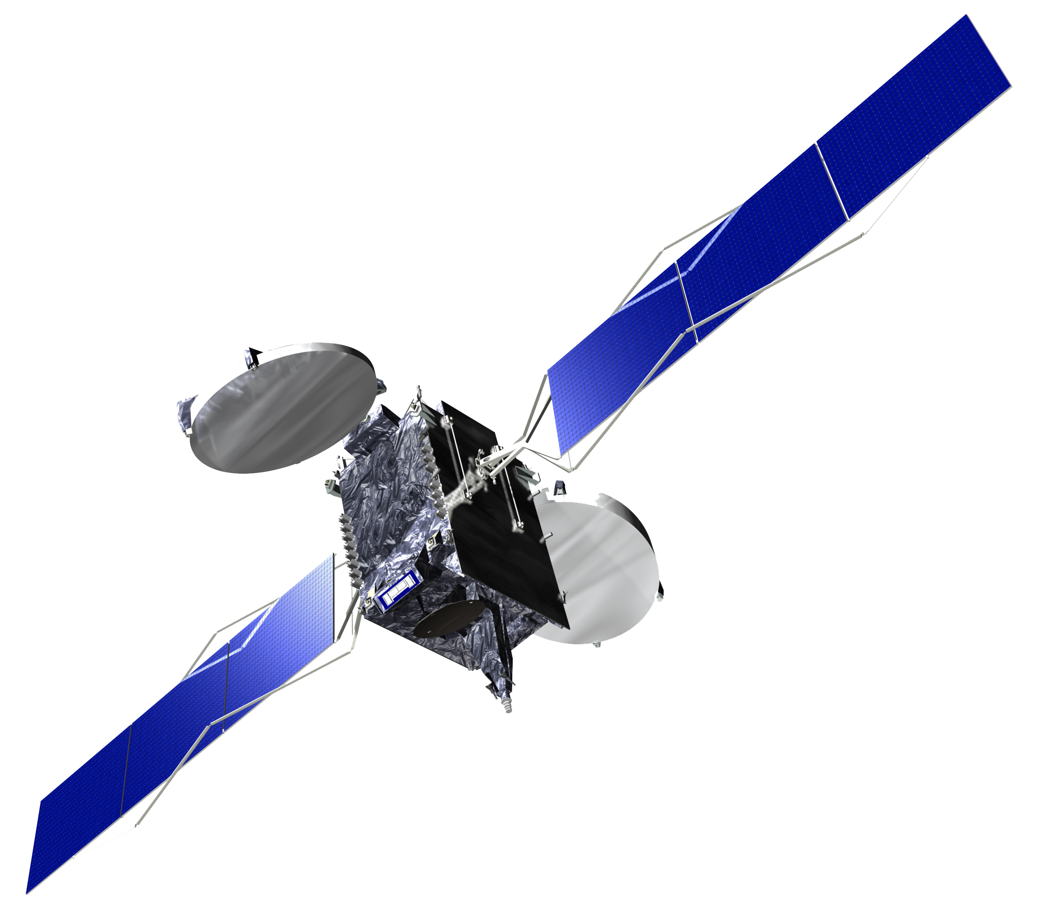
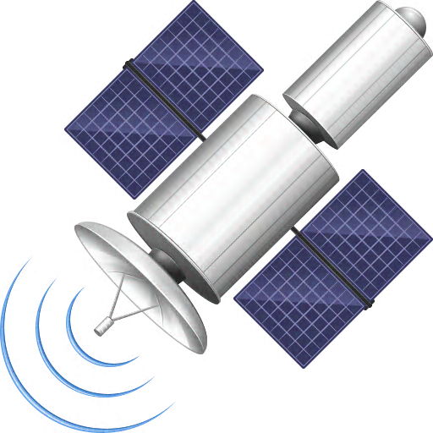

62 years of Humans in Space = lots of Space Debris
Objects in orbit remain there a long time
We currently catalogue objects in space that are 10 cm and above in size
About 24k objects currently
Small objects (below 10 cm) can still cause debilitating damage traveling at orbital speeds.

Slide 4
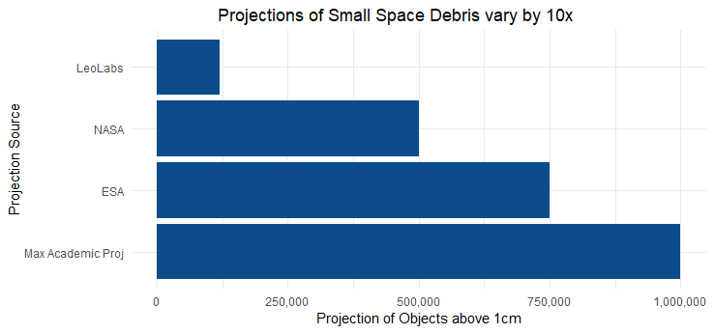
we are NOT Good at measuring Small Space Debris
Of all orbiting objects, we currently have the ability to track only about 5% of objects 2 cm or greater in size.
Projections agree that there is a lot more of small debris (.1- 10 cm) than those currently catalogued, but they vary greatly in how much

Slide 5
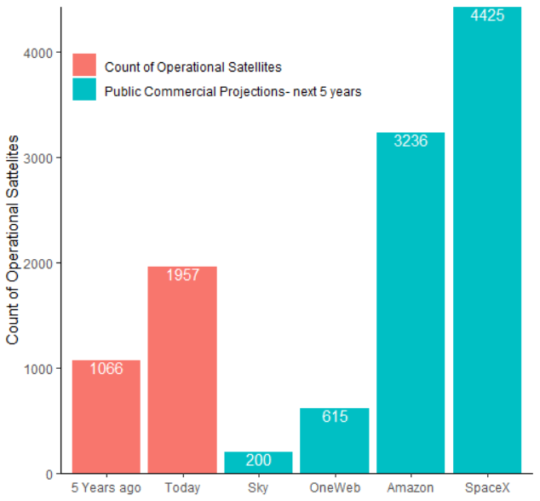
Demand for Satellites is Sky- Rocketing
The computing and networking revolution has made satellites more efficient and powerful
Invention of ‘cube-sats’ has made satellites smaller in size, harder to track in orbit
The number of operational Satellites has doubled the last 5 years, it is expected to triple in the next 5 years
Commercial and Governmental involvement will continue increasing

Slide 6
THE SPACE DEBRIS ANALYTICS PROGRAM
Analytic Models
Modern Geospatial Analytic techniques such as geo- clustering, distribution modeling, point pattern analysis
Models will use data fed from radars/ telescopes to precisely
calculate velocity, altitude, and projected movement
Radar Calibration
Utilize radar/ telescope systems from around the globe to feed models triangulated location data
Radar/ Telescope data will gather small Space Debris object location data in TLE format
THIS WILL BE OUR FUTURE IF WE DO NOT ACT

Slide 7
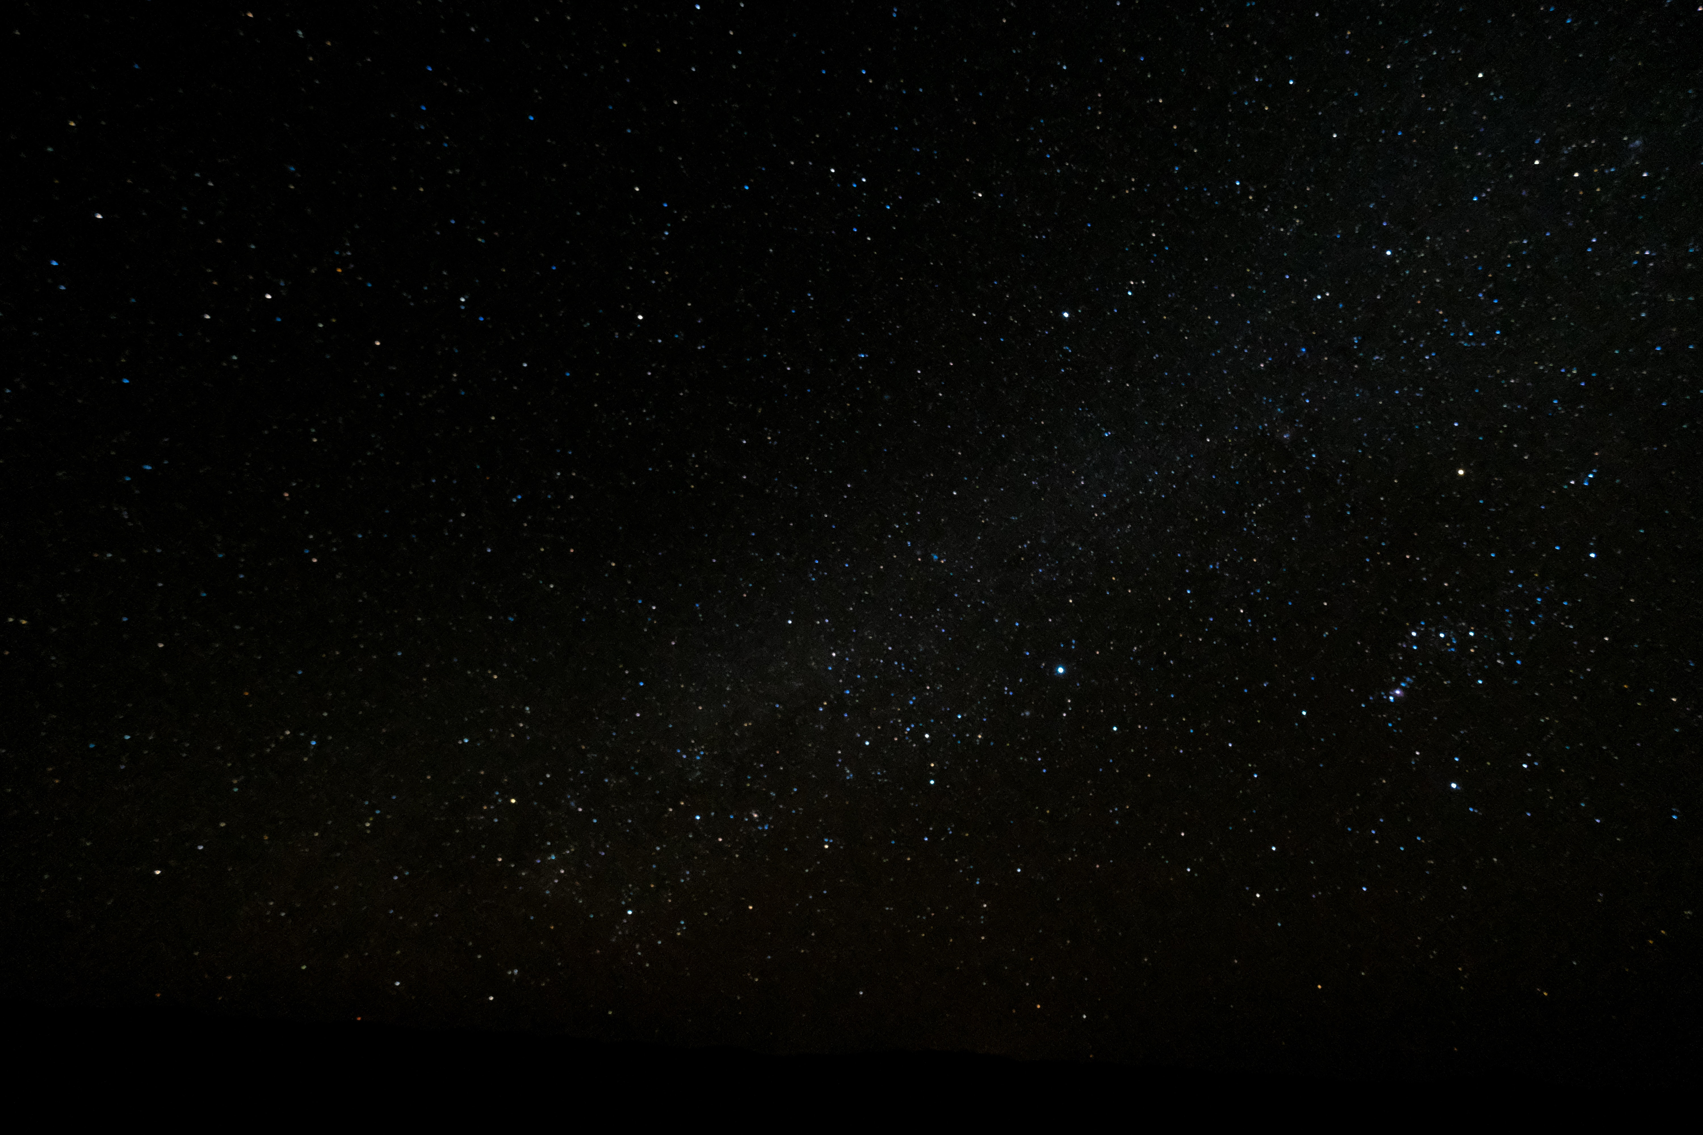
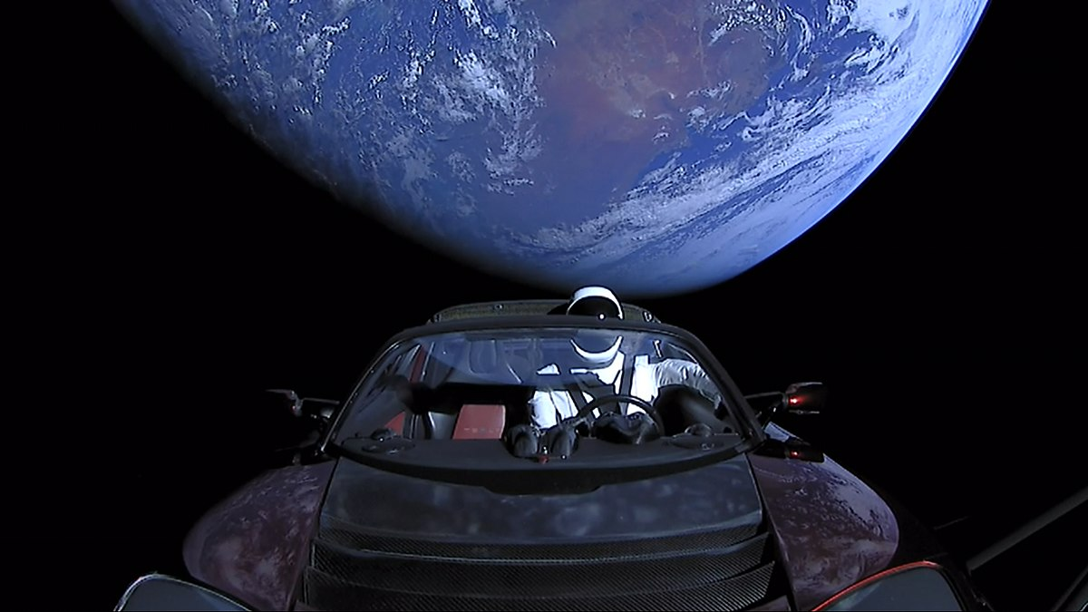
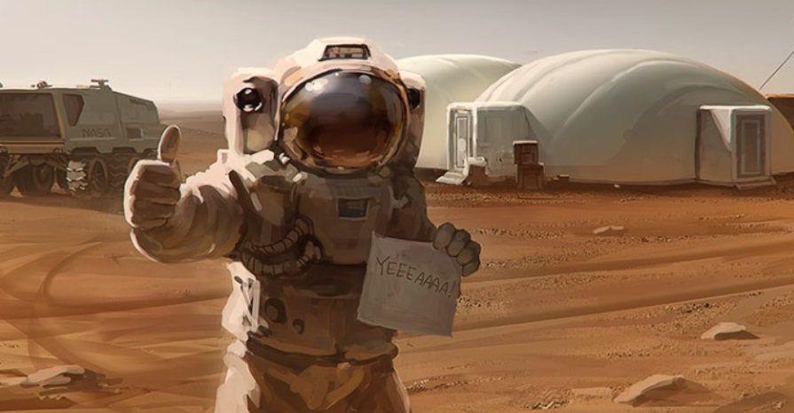
INVEST IN THE SPACE DEBRIS ANALYTICS PROGRAM
IT WILL:
PRODUCE accurate and reliable data on small space debris for us to catalogue and monitor
PROTECT our Networks and allow for less risk in future technological expansions in LEO and beyond
MAINTAIN earths orbital ecosystem manageable for consumption by future generations
IMPROVE the opportunity for future human exploration and for mankind to become an interplanetary species

Slide 8

ALRIGHT..
ALRIGHT..
ALRIGHT

